Slide 1

SUPERSTORE ANALYSIS
POWERPOINT by KEITA + NICK

Slide 2

AGENDA
Analytical Plan
EDA
What are we trying to solve, what data are we using, what is our overall workflow?
What kind of insights is our data telling us?
Modelling
Conclusion
What kind of predictions can be made?
What is our findings and recommendation for the top 10 DMA locations?

Slide 3

Analytical Plan

Slide 4

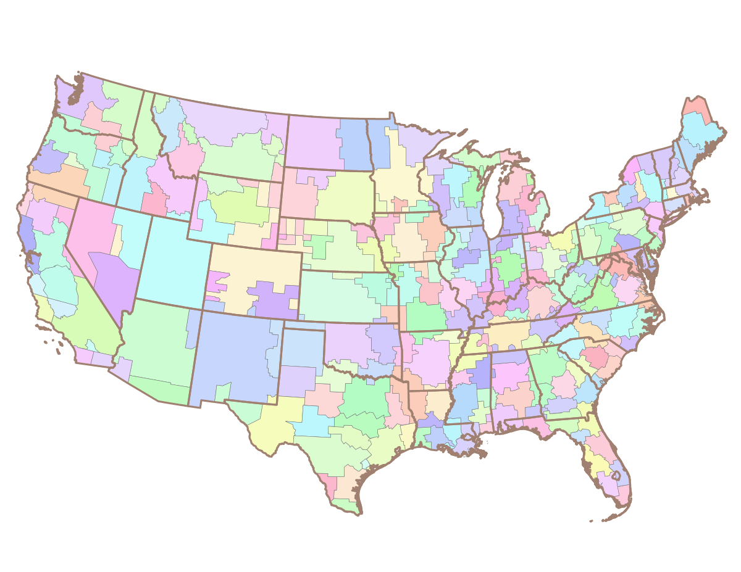
Goal: Find 10 DMA Locations
Notes:
Understanding data (dataset description)
Clean data (R)
(Maybe) Creating relational schema

Slide 5
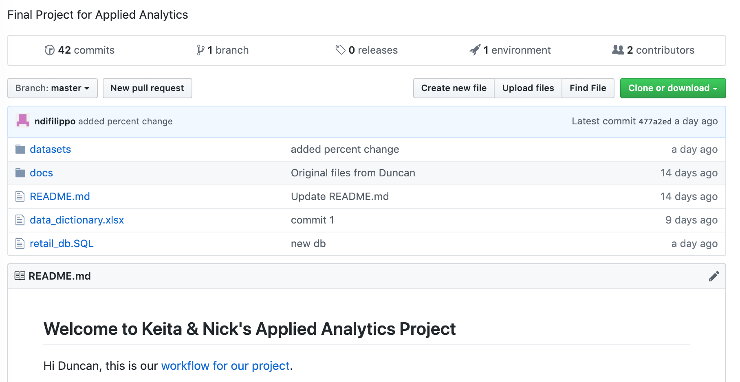
Result
GitHub
Version control
Share findings
Analytical Plan
Finding
X-Factor

Slide 6
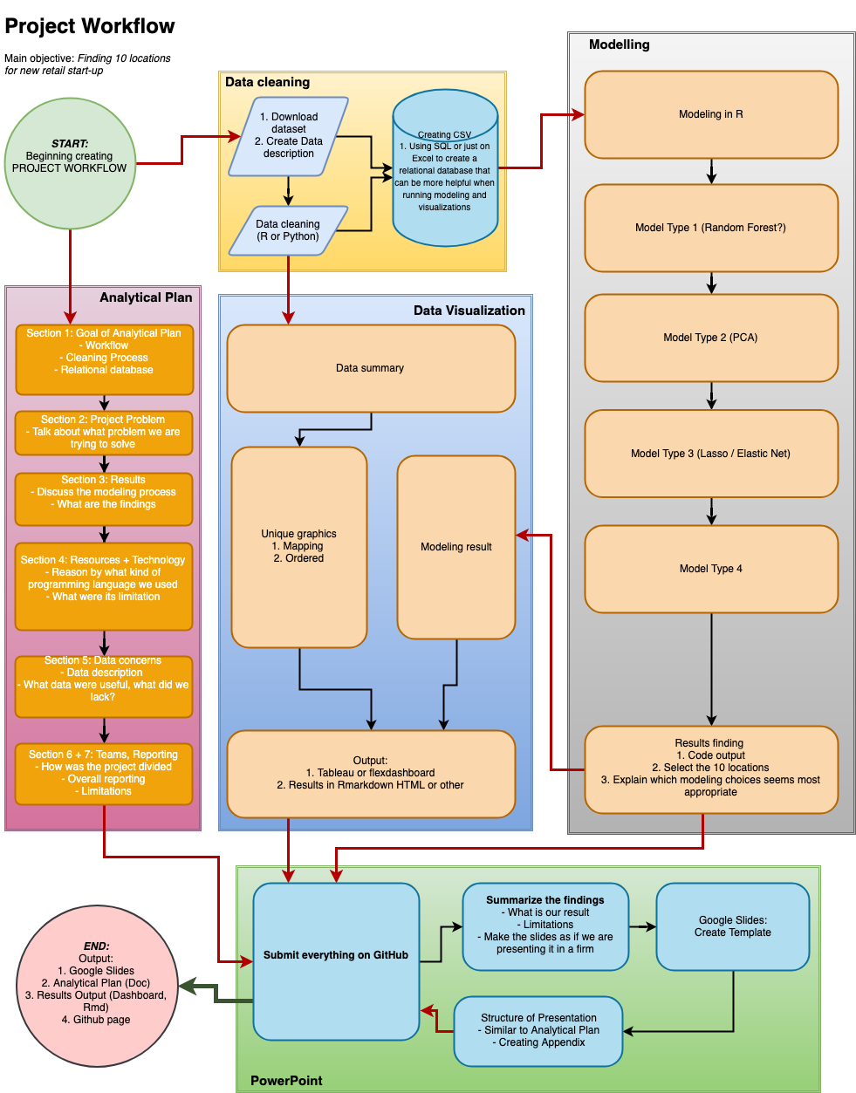
Workflow

Slide 7



Additional Data

Slide 8
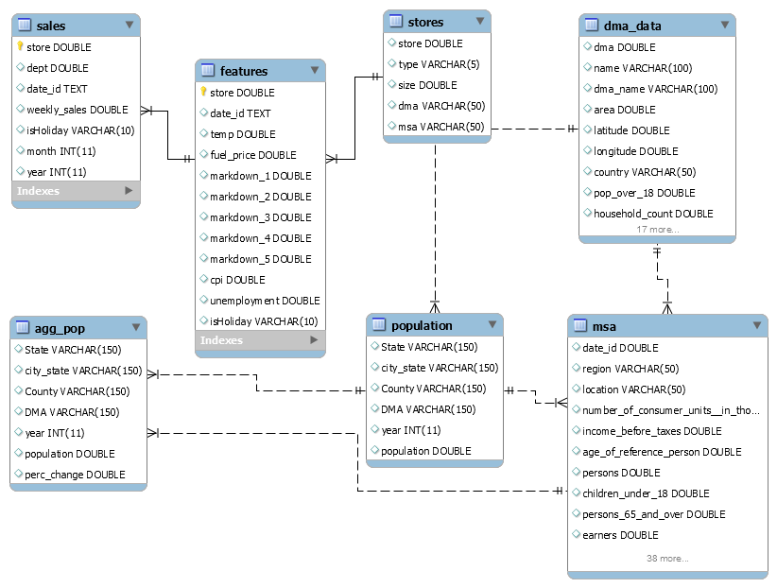
Data Cleaning

Slide 9
EDA

Slide 10

Exploratory Data Analysis

Slide 11

Notes:
LiveSlide Site
https://public.tableau.com/shared/T598ZNZTD?:display_count=yes

Slide 12
Exploratory Data Analysis
Additional DMA:
Raleigh-Durham
Charlotte
5.6 unemployment

Slide 13
Modelling

Slide 14
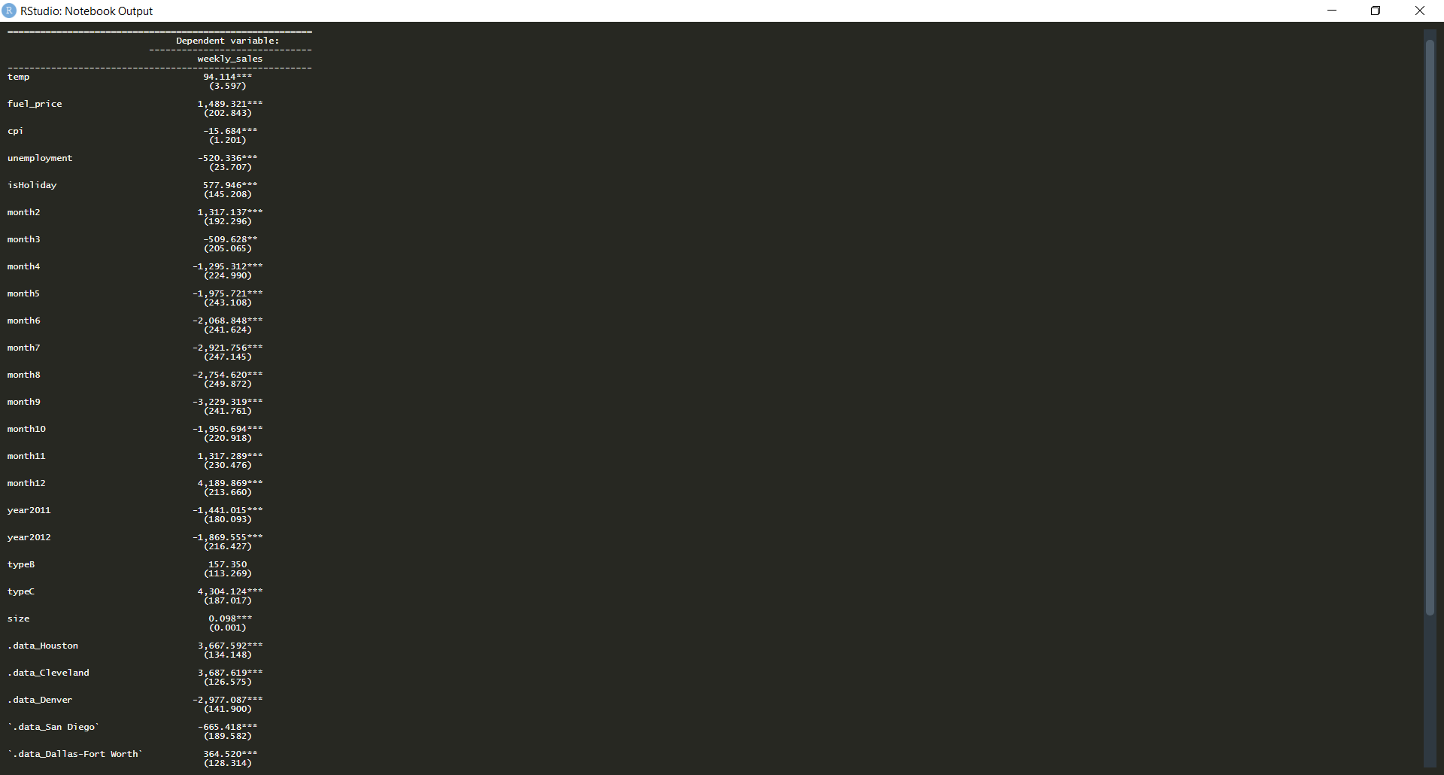
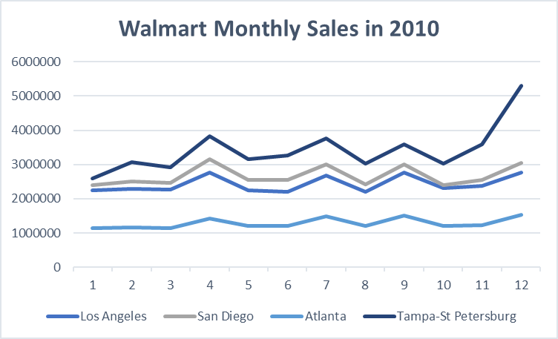
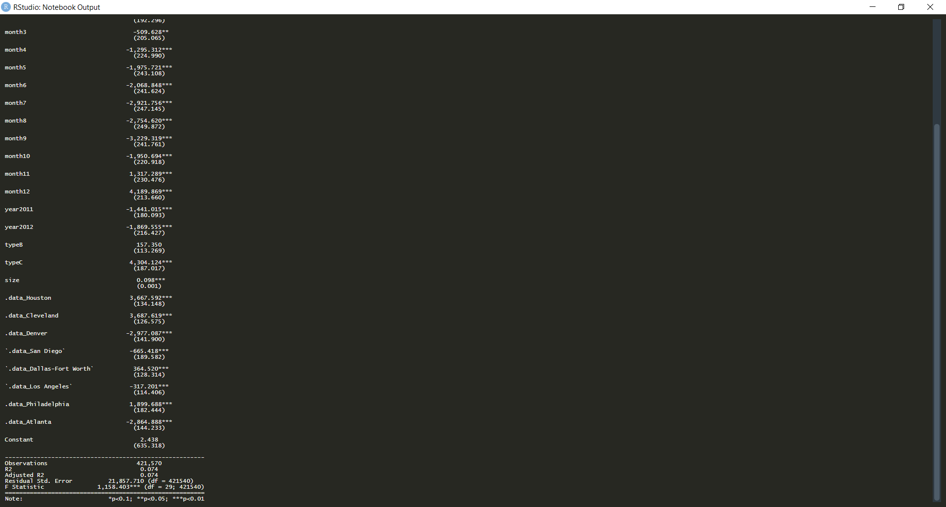
Linear Regression
OLS model Fails to Explain Walmart Sales Variation
Walmart Sales data contradicts the model

Slide 15
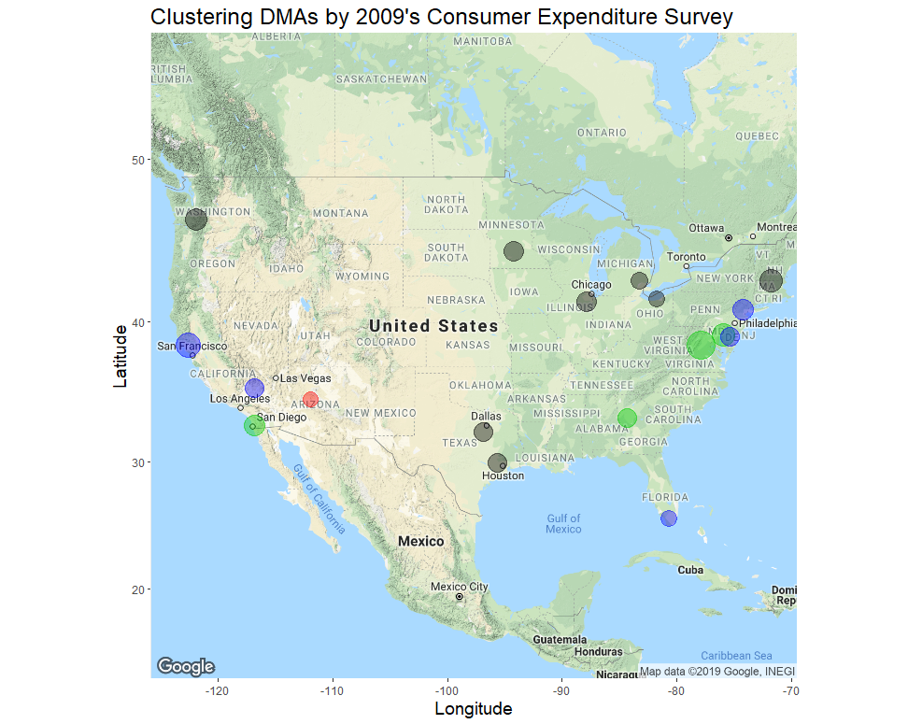
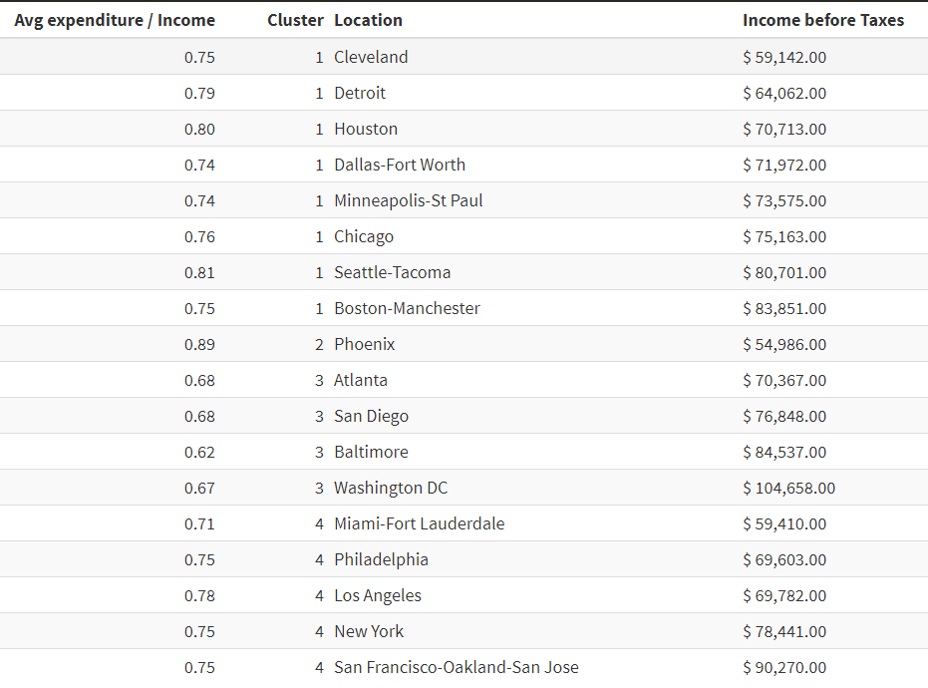
Clustering DMAs by Spending Behavior
Used K-Means Clustering for DMAs by the using
Consumer Expenditure Survey for 2009
Expenditure variables are a fraction of income
Nick
Source : https://maps.googleapis.com/maps/api/staticmap?center=37.721667,-97.757778&zoom=4&size=640x640&scale=2&maptype=terrain&language=en-EN&key=xxx-7LY5-cbjHsc

Slide 16
Conclusion

Slide 17
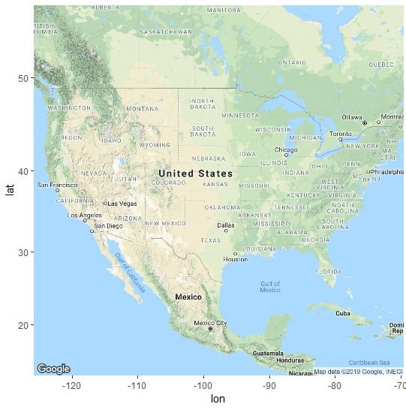
Conclusion
Top 10 Locations to Launch a Retail Business
Houston, TX
Dallas – Fort Worth, TX
Minneapolis-St Paul, MN
Chicago, IL
Seattle, WA
Boston, MA
Charlotte, NC
Raleigh – Durham, NC
Los Angeles, CA
San Francisco-Oakland-San Jose, CA

Slide 18


Thank you for your attention.
Notes:
Image source:-
https://pixabay.com/en/coding-programming-working-macbook-924920/

